Slide 1
Advanced Programming Compiling & Debugging
Pieter Jorissen

Slide 2
The Visual Studio Environment
Visual Studio is an integrated development environment (IDE)
The IDE consists of tools including
Form designer
Editor
Compiler
Debugger
Object browser
Help facility => msdn
…

Slide 3
Microsoft’s Visual Studio.NET
Includes C#, Visual Basic, Visual C++, … and the .NET Framework
The Framework allows objects from different languages to operate together
All .NET languages compile to Microsoft Intermediate Language (MSIL)
Managed code runs in the Common Language Runtime (CLR)

Slide 4
C# Application Files
.sln The solution file
.suo Solution user options file
.cs Holds definition of a classes, …
.resx Resource file for a form
.csproj A project file
.csproj.user The project user option file

Slide 5
C# Modes
Design time – Used to design the user interface and write code
Run time – Used for testing and running a project
Break time – Occurs when you get a run-time error or pause project execution => for debugging

Slide 6
Run the Project
Ways to run the project
Open the Debug menu and choose Start
Press the Start button on the toolbar
Press CTRL+F5, the shortcut key for the Start command
Go to [Project Folder]\bin\Debug and execute

Slide 7
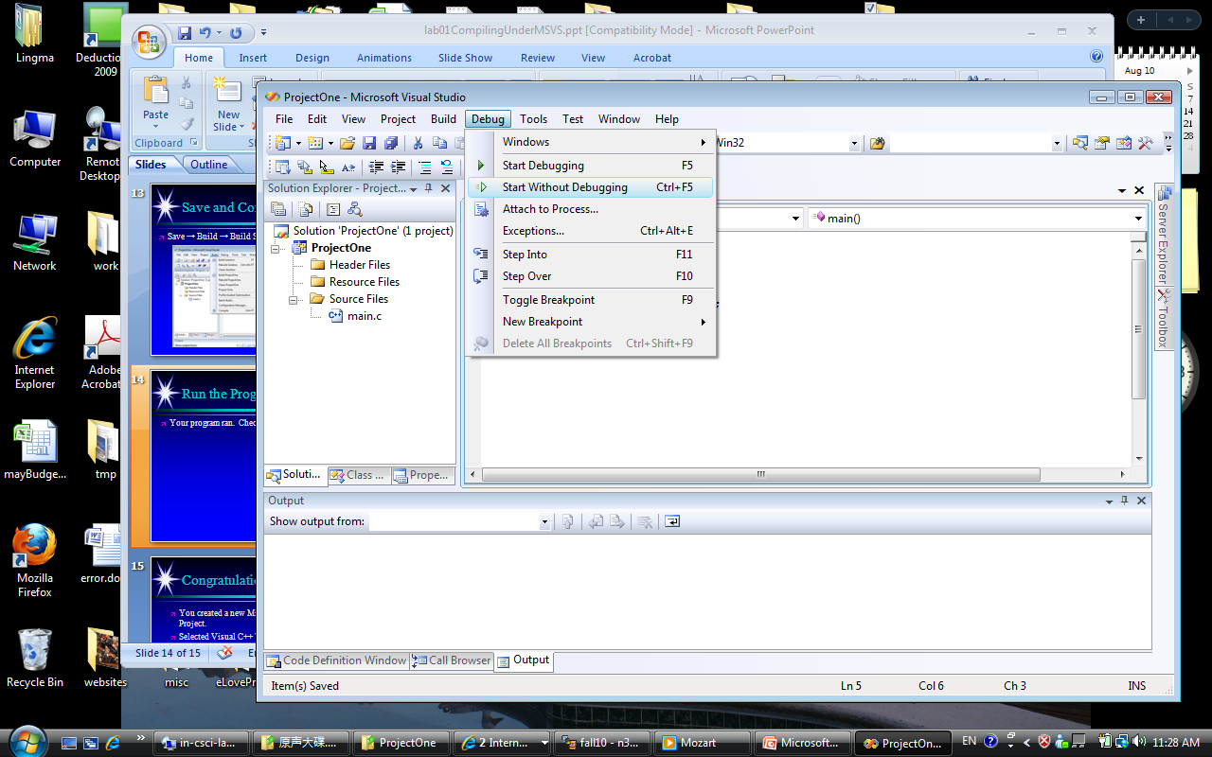
Run the Program
After a successful build, Debug →Start Without Debugging to run the program:

Slide 8
Compiled vs. Interpreted
Compiled (e.g. C#, C/C++, VB.Net,…)
Executes faster
Occupies less main memory (RAM)
Interpreted (e.g. JavaScript, Python, …)
Provides run-time error and security checking
Allows platform independence
Produces smaller code

Slide 9
Compiling and Executing a Program in .Net
After creating source code, you must do the following before you can view the program output (VS does this for you):
Compile (build) the source code into intermediate language (IL)
Use the C# just in time (JIT) compiler to translate the intermediate code into executable statements

Slide 10
Compiling and Executing a Program
After compiling your source code you will have 2 possible outcomes:
You receive one or more program language error messages
You receive no error messages, indicating that the program has compiled successfully

Slide 11
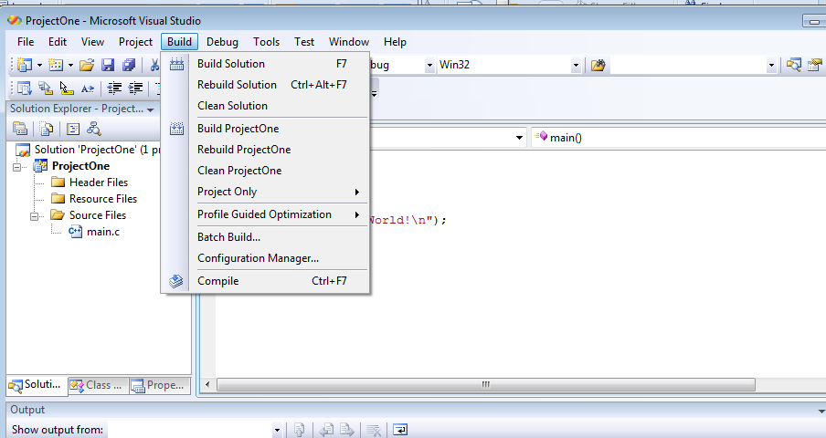
Save and Compile Your Program
Save → Build → Build Solution

Slide 12
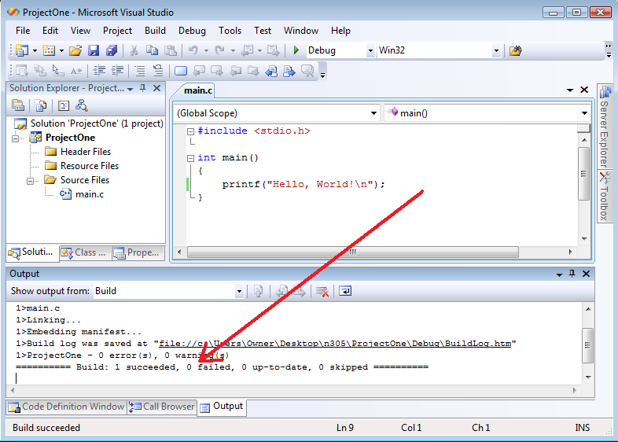
Save and Compile Your Program
A successful build:

Slide 13
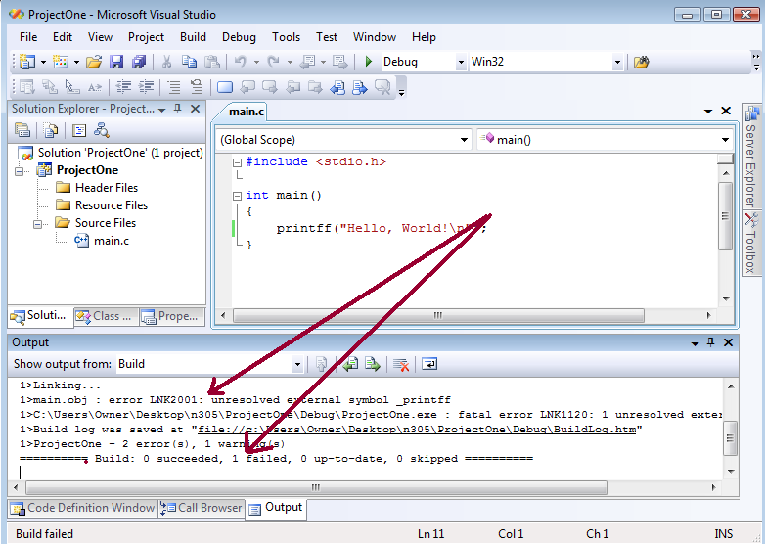
Save and Compile Your Program
An unsuccessful build, read the error message and correct the errors and build again:

Slide 14
Finding and Fixing Errors
Three types of programming errors:
Syntax errors
Run-time errors
Logic errors

Slide 15
Syntax Errors
Occur if you break C#’s rules for syntax: punctuation, format, or spelling
A fatal error that the programmer must correct before being able to fully compile the program.
Smart editor finds most syntax errors
A squiggly line is placed under the part of code line that the editor cannot interpret
Double-click on error in Task list to jump to error line
A compile error is an error found by the compiler => the program will not be compiled

Slide 16
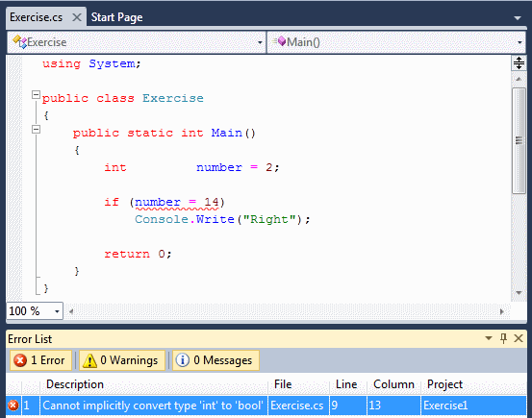
Syntax Error

Slide 17
Run-Time Errors
Program is compiled and running
Some code causes project to halt execution
E.g. divide by zero, write outside array range,…
C# displays dialog box and highlights statement causing the error
Statements that cannot execute correctly cause run-time errors

Slide 18
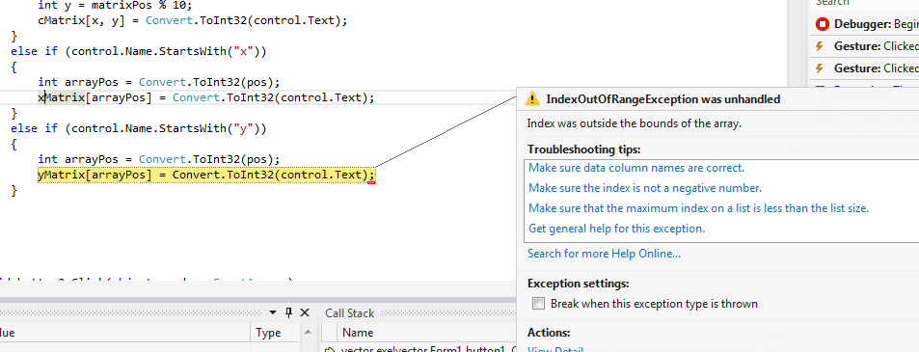
Run-Time errors

Slide 19
Logic Errors
Program runs but produces incorrect results
Check all aspects of the project output
Computations
Text
Spacing
=> Debugging

Slide 20
Project Debugging
Debugging – Finding and fixing “bugs” in code
Recompile program after debugging
A clean compile only means you have zero syntax errors when you compile your program

Slide 21
How to Debug?
The basic steps in debugging are:
Recognize that a bug exists
Isolate the source of the bug
Identify the cause of the bug
Determine a fix for the bug
Apply the fix and test it
Tools
Walk through your program
Display the variables at certain points, trace the program
Use of professional debugger

Slide 22
Debugging .NET Programs
Use debugging tools
Set breakpoints and correct mistakes.
Use a Watch/Local/autos window to examine variables during program execution.

Slide 23
Logic error example
If (age > 13 And age < 20)
{
TextBox2.Text = “You’re a teenager”
}
Else
{
TextBox2.Text = “You’re not a teenager”
}
A teenager is a person who is between 13 and 19 years old

Slide 24
The structure fails to identify the person who is exactly 13

Slide 25
Debug Tool Bar
Break mode gives you a close-up look at your program it is being executed.
Step Into
Watch1
Break All
Step Out
Start
Step Over
Locals
Breakpoints
Stop
Run To Cursor

Slide 26
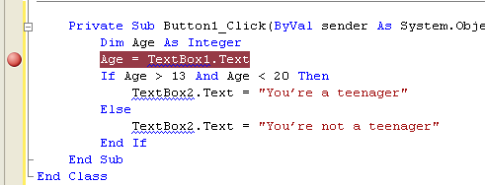
Breakpoint
You can set a breakpoint by clicking the gray margin to the left of the line of code shown. (or by F9)
Gray margin
Breakpoint

Slide 27
Debug Toolbar
Step Into (F11)
You can step through your code line by line.
This includes stepping into any function or procedure that the code calls .
Step Over (F10)
Works in a similar way to Step Into, but you pass straight over the procedures and function

Slide 28
Debug Toolbar
Step Out (shift+ F11)
This allows you to jump to the end of the procedure or function that you are currently in
Move to the line of code after the line that called the procedure or function.
This is handy when you step into a long procedure and want to get out of it.

Slide 29
Debug Toolbar
Run To Cursor (ctrl+F10)
Enable you to place your cursor anywhere in the code following the current breakpoint.
The code between the current breakpoint where the cursor is positioned will be executed
The execution will stop on the line of code where the cursor is located.

Slide 30

Working With Breakpoint
To view the Data Tip hover the mouse over the variable.

Slide 31

Debug windows
Use Output-window
Locals-, Autos- en Watch-window
Only the scope differs
In some environments/languages you can also change values
Other windows
Me-window
Threads-window
Module-window
Register-window
Memory-window
Call Stack

Slide 32
Watch Window
It is provides a method for you to watch variable and expressions easily while the code is executing.
You can add and delete only when your program is in break mode.
It is allow to change the value of a variable.
The text for the value turn to red.
You need to set a breakpoint before the variable that you want to watch

Slide 33
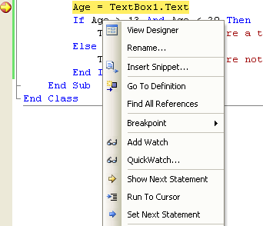
Watch Window

Slide 34
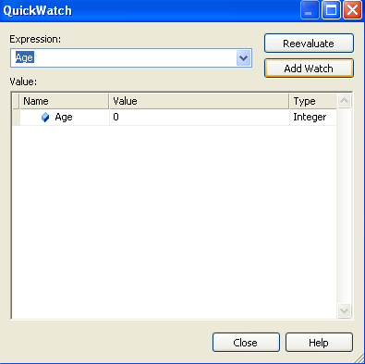
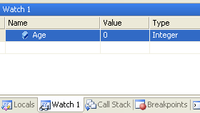
Watch Window

Slide 35
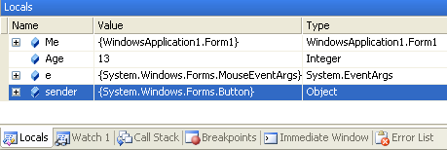
Local Window
It is similar to the Watch window.
It shows all variables and objects for the current function or procedure.

Slide 36
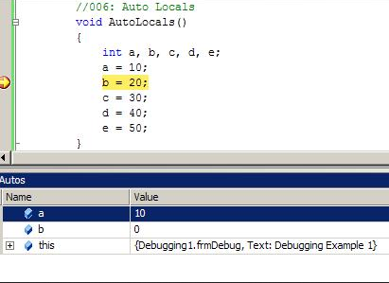
Autos Window
It is similar to the Local window.
It shows all variables and objects for the current statement and the previous statement.

Slide 37
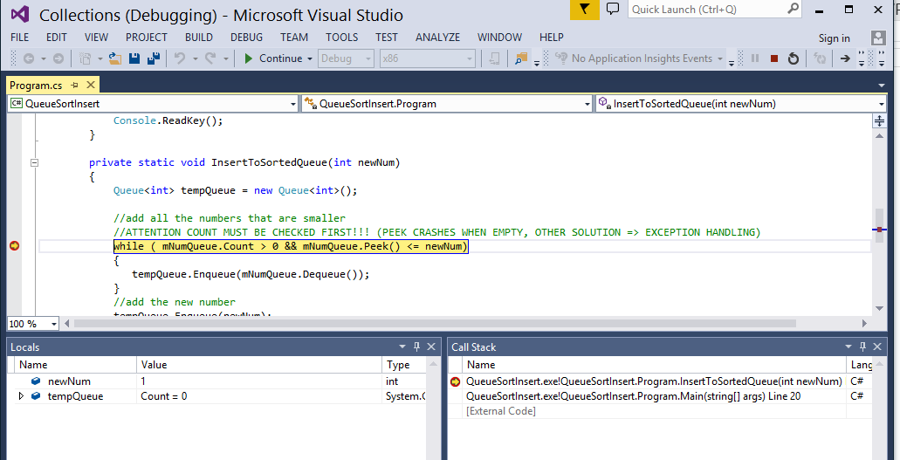
Call Stack
By using the Call Stack window, you can view the function or procedure calls that are currently on the stack.

Slide 38
Debug VS Release

Slide 39
Debug vs release mode
Debug mode and Release mode are different configurations for building your .Net project.
Programmers generally use the Debug mode for debugging step by step their .Net project and select the Release mode for the final build of Assembly file (.dll or .exe).

Slide 40
Debug mode
does not optimize the binary it produces because the relationship between source code and generated instructions is more complex.
This allows breakpoints to be set accurately and allows a programmer to step through the code one line at a time.
your program is compiled with full symbolic debug information which help the debugger figure out where it is in the source code.

Slide 41
.pdb files
Debug information can be generated in a .pdb (Program Database File) file depending on the compiler options that are used.
This holds debugging and project state information that allows incremental linking of a Debug configuration of your program.
A Program Database File is created when you compile a program with debug mode.

Slide 42
Release mode
The Release mode enables optimizations and generates without any debug data,
it is fully optimized.
The resulting executable will most likely not match up with your written code.
Because of this release mode will run faster than debug mode due to the optimizations.

Slide 43
Be careful
These are different configurations with different settings
This means that in some situations Release works differently
E.g variable initialization, default values,…
Also your executable will be in bin\Release

Slide 44
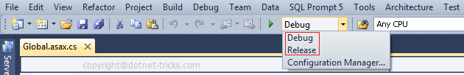
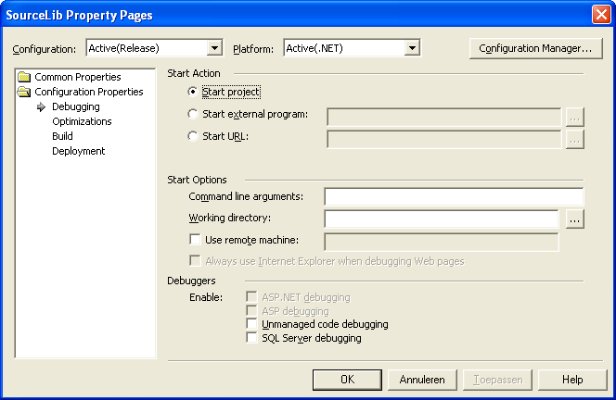
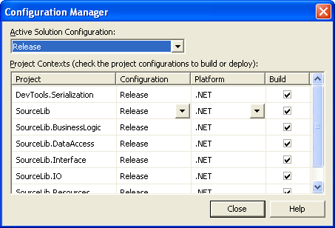
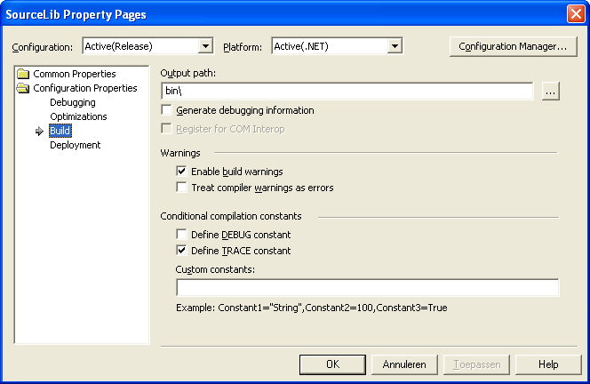
Configuration Manager
Buildconfiguraties are on 2 levels
Project
Solution

Slide 45
Oefening
Gebruik de klasse Stopwatch om in (eender welke) vorige oefening te meten hoe lang het duurt om het programma volledig te runnen
(gebruik een oefening die wel iets voldoende lang doet, bvb recursive, of een hele hoop berekeningen, vergroot evt een loop)
Voer dit uit in debug en release mode, wat is het verschil?

Slide 46
MSDN - HELP

Slide 47
Viewing Help Topics
To view a Help topic:
Choose Contents, Index, or Search
Select a topic
Page appears in the Document window
Filter the Help topics with Filtered By
Press F1 for context-sensitive Help
Press Shift + F1 for context-sensitive Help about the environment

Slide 48
Visual Studio Help
Visual Studio Help includes the Microsoft Developer Network library (MSDN) which provides:
Books
Technical articles
Microsoft Knowledge Base
Reference materials for the Visual Studio IDE, the .NET Framework, C#, Visual Basic, and C++

Slide 49
Installing and Running MSDN
You can run MSDN from
A hard drive
A network drive
A CD
The Web
By default, MSDN is installed on the hard drive
Voor het examen: installeer op je HD

Slide 50
Vragen

Slide 51
OPDRACHTEN
Zoek de fouten in de oefeningen van Debugging (zie BB)
Alle types errors kunnen voorkomen
Los eerst de syntax errors op
Daarna zoek en controleer je op logische fouten mbv debugging
Daag je collegas uit met je meest irritante bug => wedstrijdjes?
(Lukt het niet met de solution, maak dan zelf je solutions en projects en kopier de code uit de cs file)

Slide 52
Performance observation & improvement: Profiling
Profiling in VS: https://docs.microsoft.com/en-us/visualstudio/profiling/profiling-feature-tour?view=vs-2019
CPU Profiling in VS: https://docs.microsoft.com/en-us/visualstudio/profiling/beginners-guide-to-performance-profiling?view=vs-2019
Profiling in Unity
https://docs.unity3d.com/Manual/Profiler.html
https://www.youtube.com/watch?v=fROTtgZK-Zs
https://www.youtube.com/watch?v=sBpXiJ9G3OY

Slide 53
Opdracht
Test de profiler op een voorgaand project
Test de profiler in Unity op een vroeger project

Slide 54
Leerstof
Deze slides
StopWatch klasse: https://docs.microsoft.com/en-us/dotnet/api/system.diagnostics.stopwatch?view=netframework-4.8
Debugging tools…
Build Settings

